Slide 1
Catalytic Ethane Dehydrogenation using a Porcupine Heating Element in a Joule-heated Reactor
Enerelt Burentugs, Raul F. Lobo
Center for Catalytic Science and Technology, Department of Chemical and Biomolecular Engineering, University of Delaware, Newark, DE, 19716, USA.

Slide 2
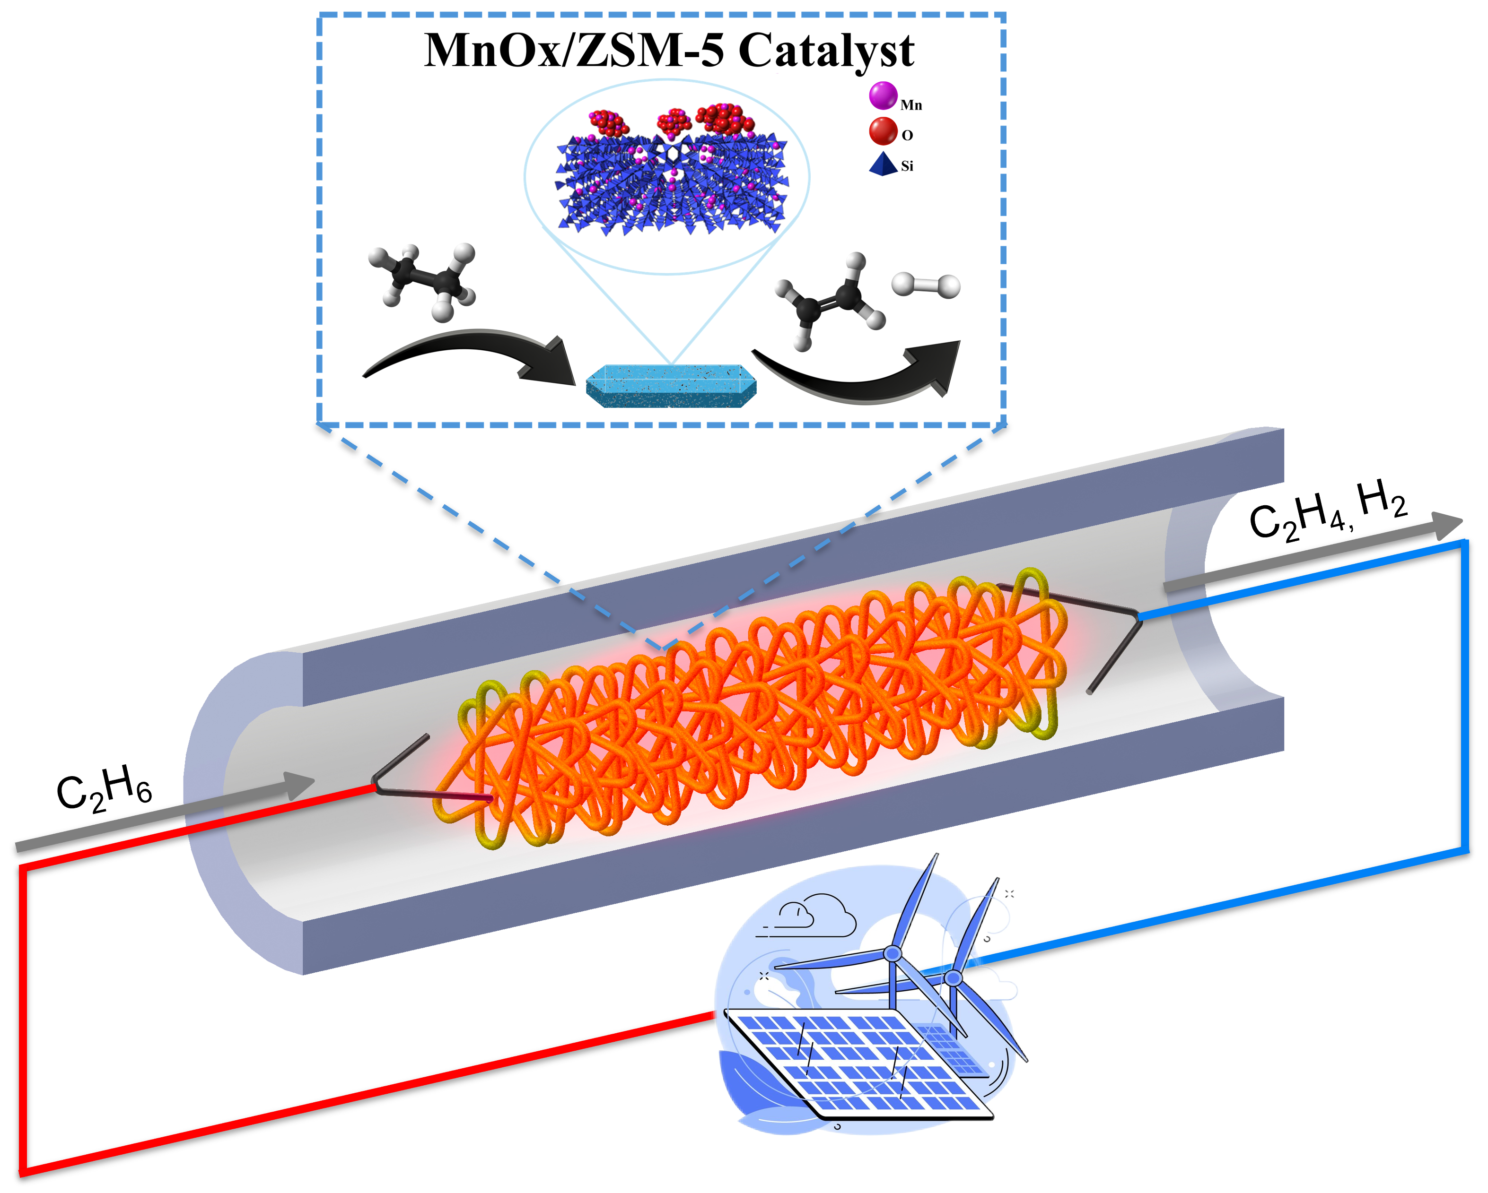
TOC

Slide 3
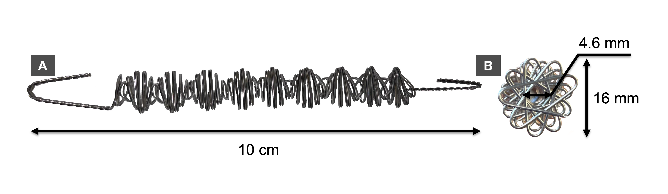
Figure 1

Slide 4
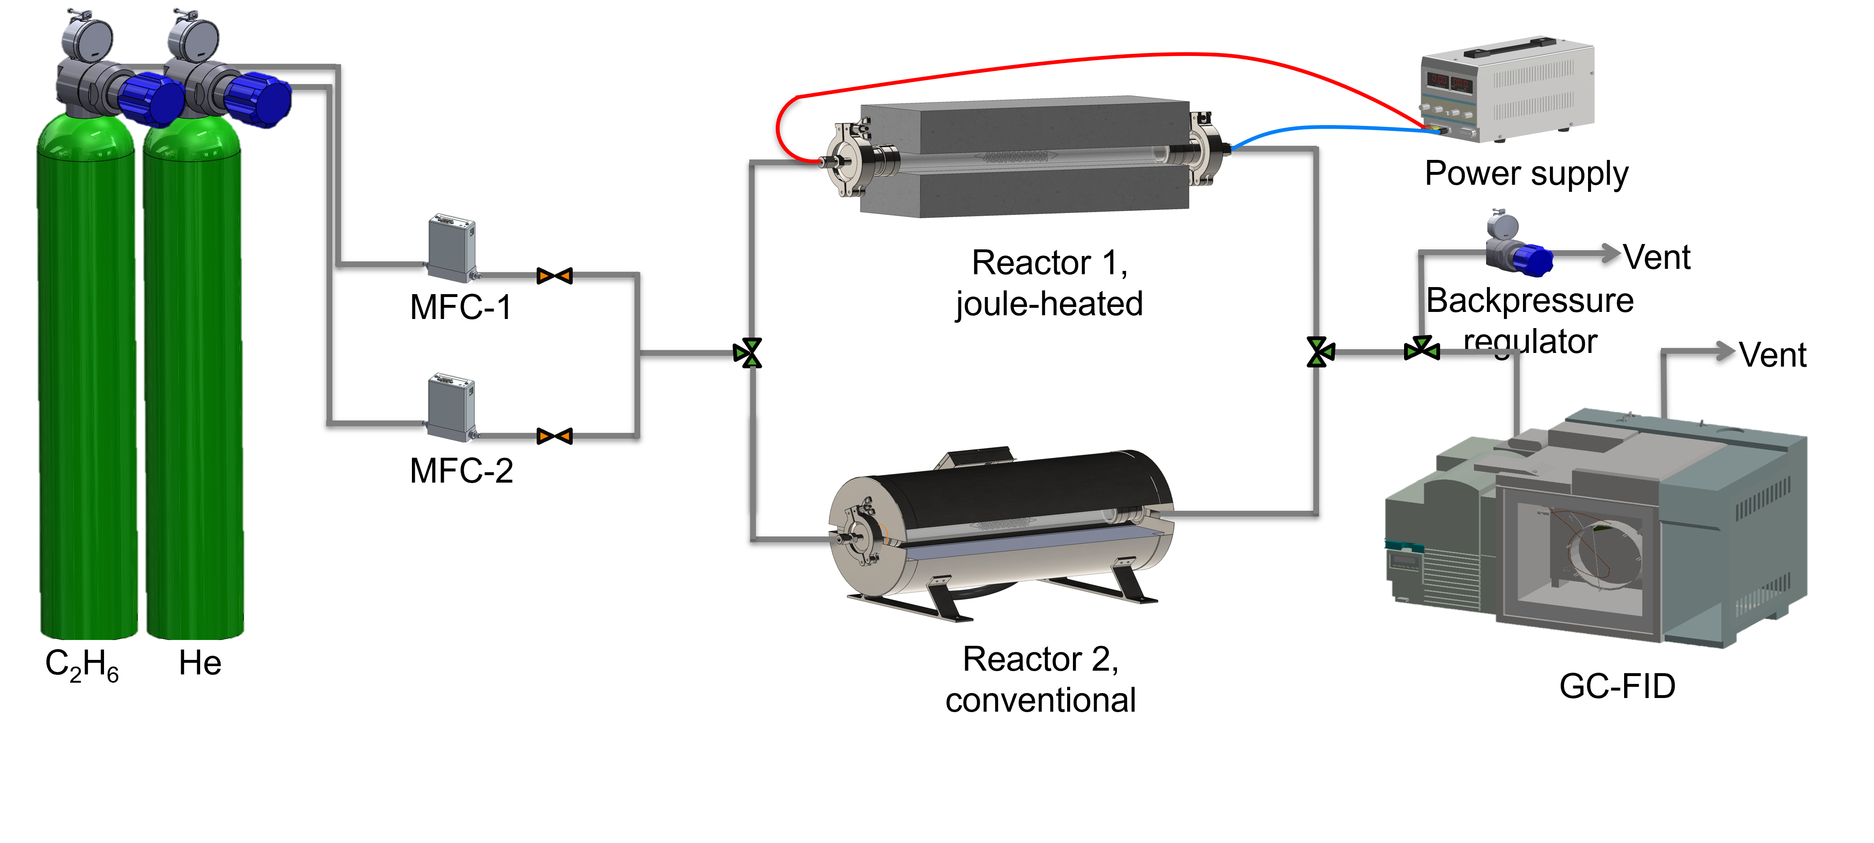
Figure 2

Slide 5
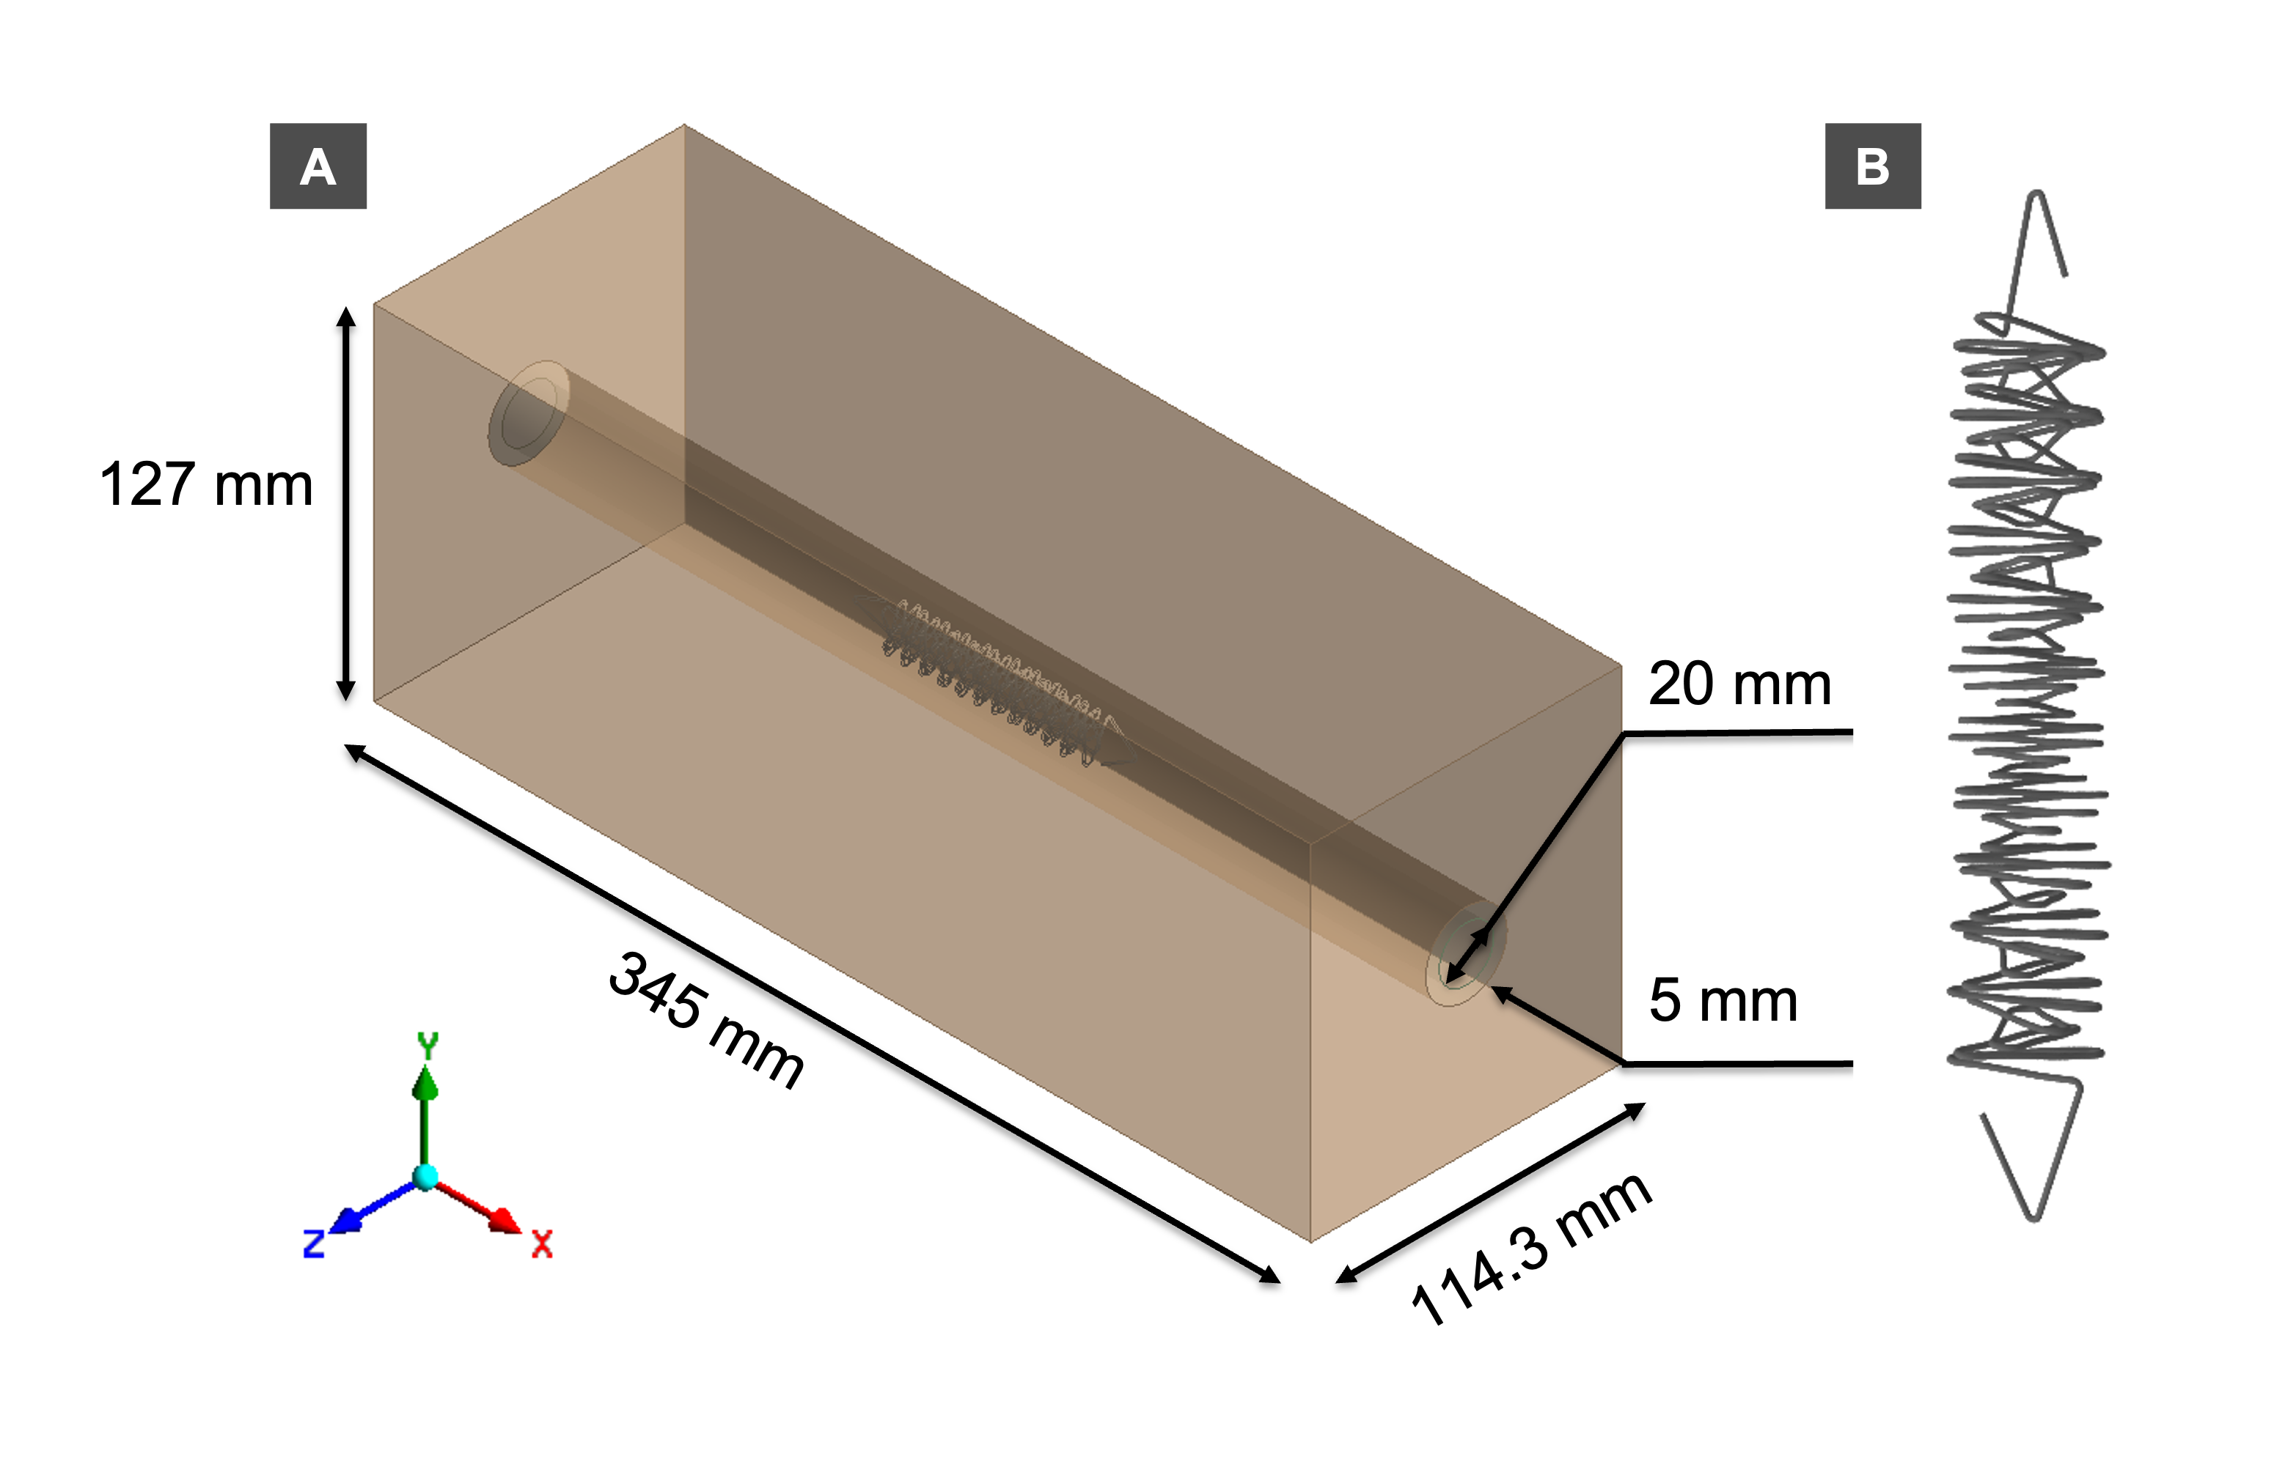
Figure 3

Slide 6
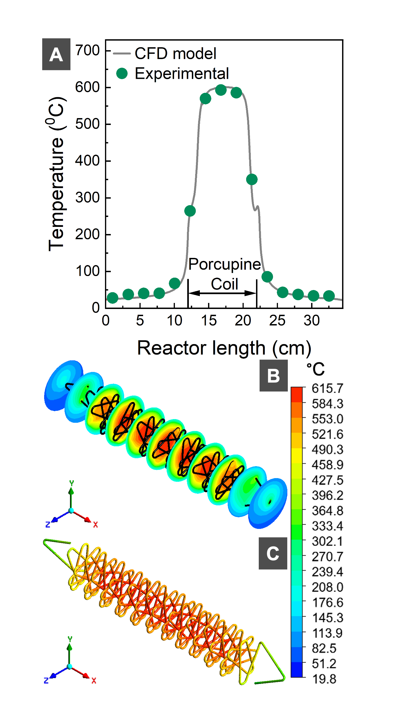
Figure 4

Slide 7
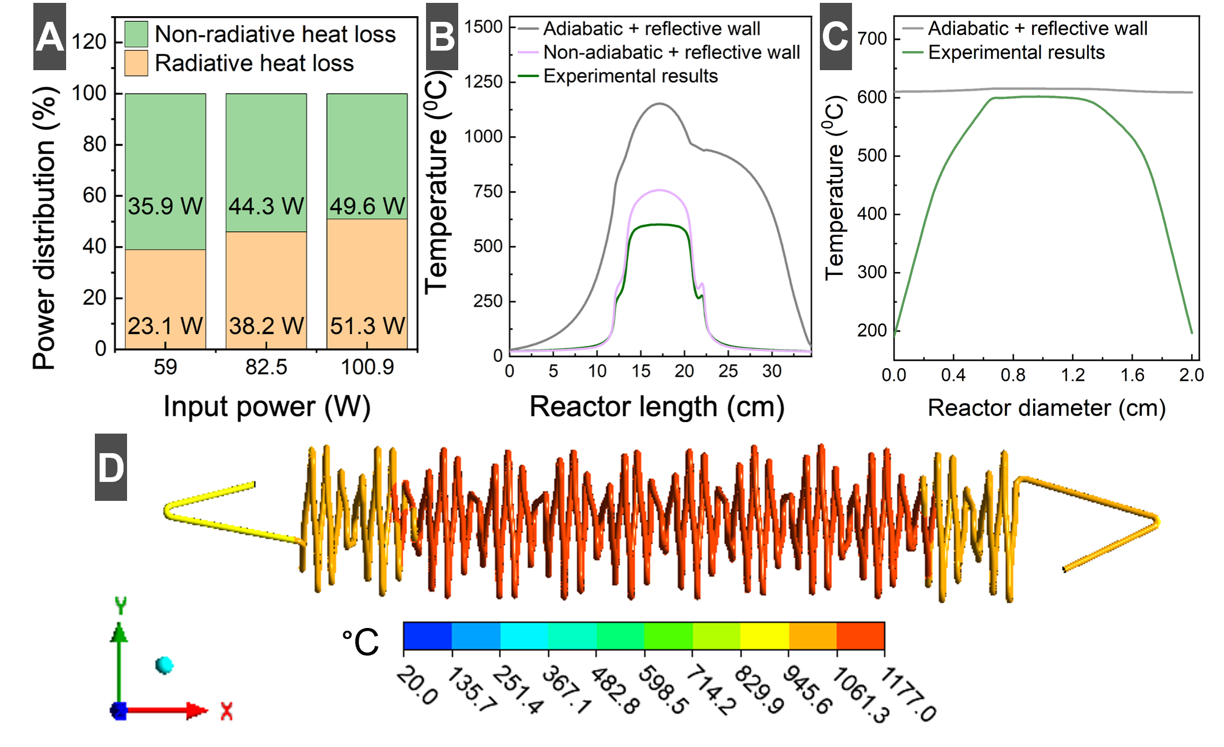
Figure 5

Slide 8
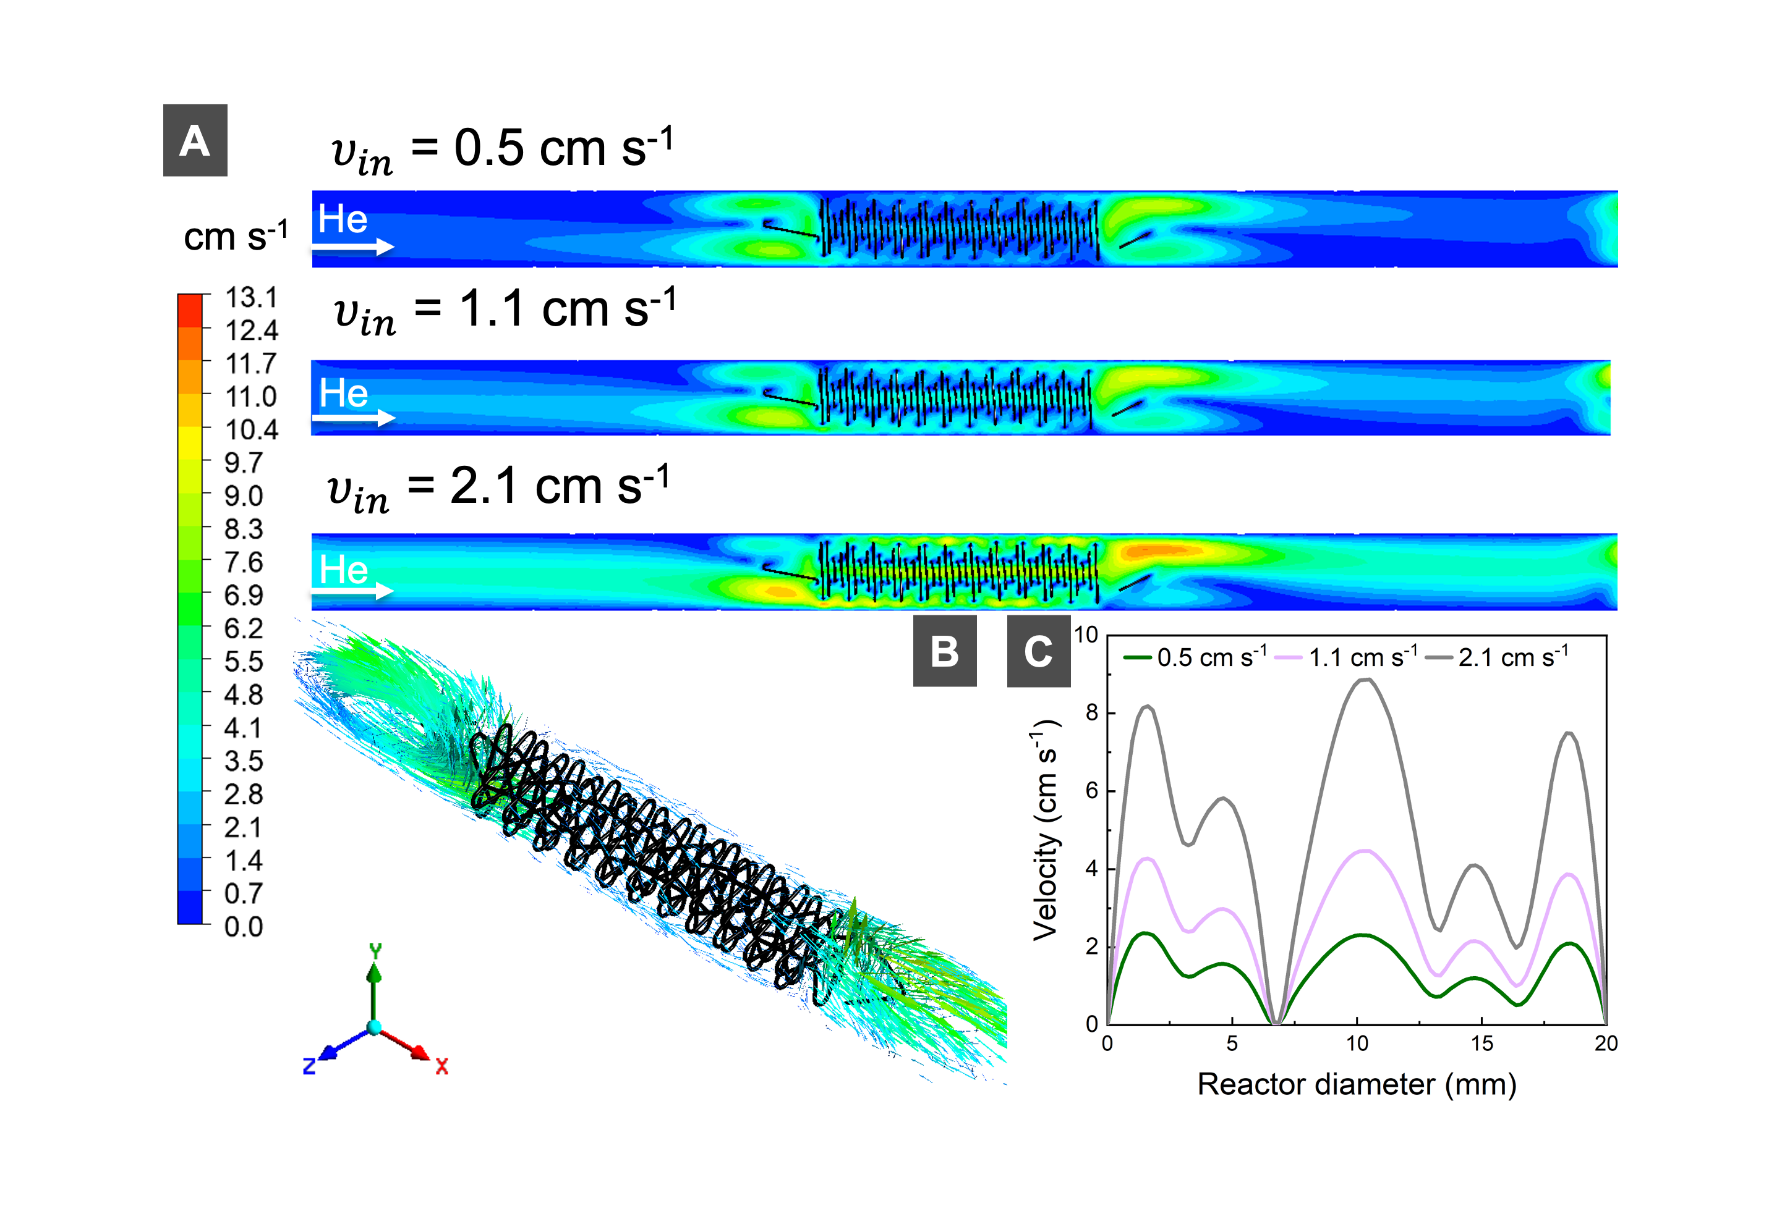
Figure 6

Slide 9
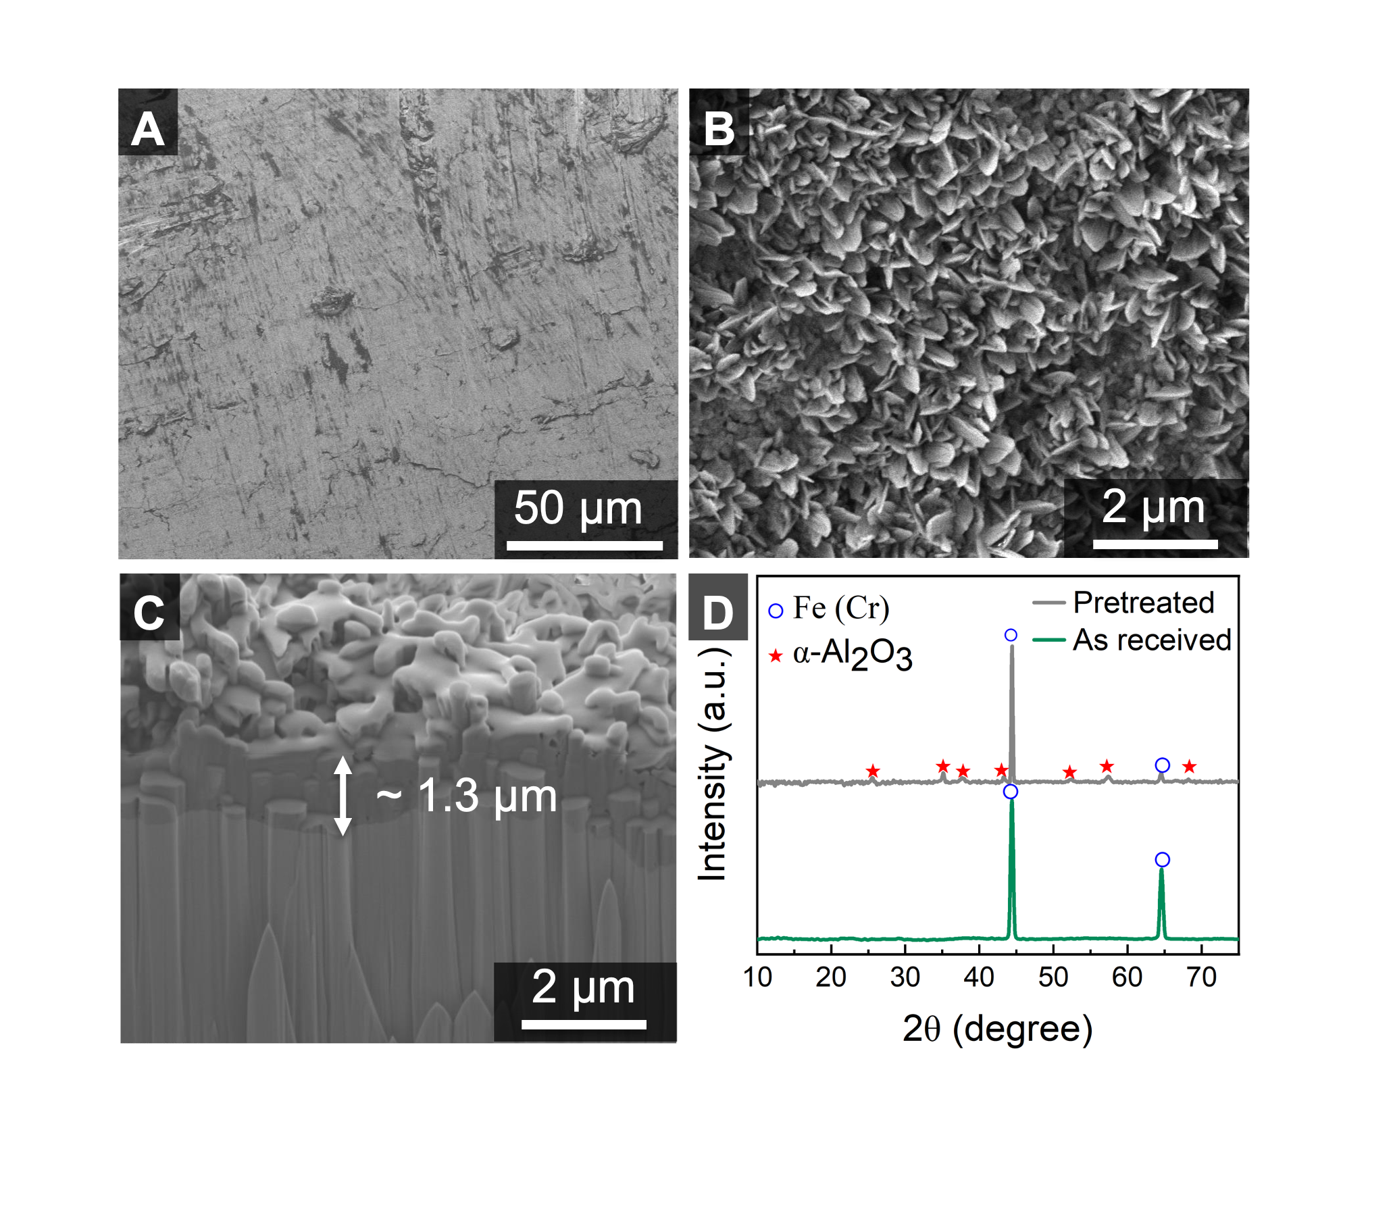
Figure 7

Slide 10
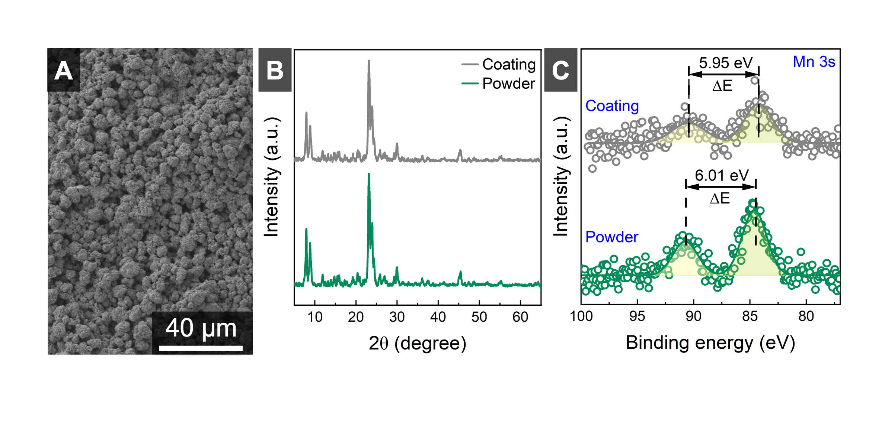
Figure 8

Slide 11
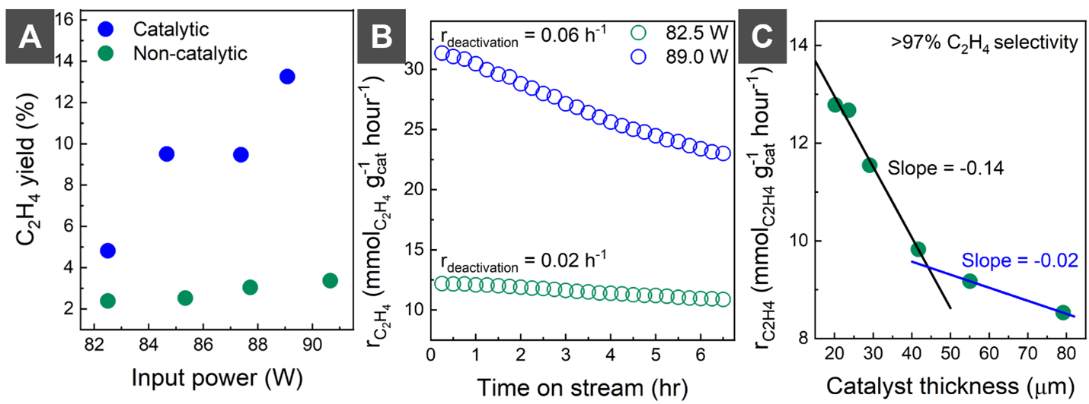
Figure 9

Slide 12
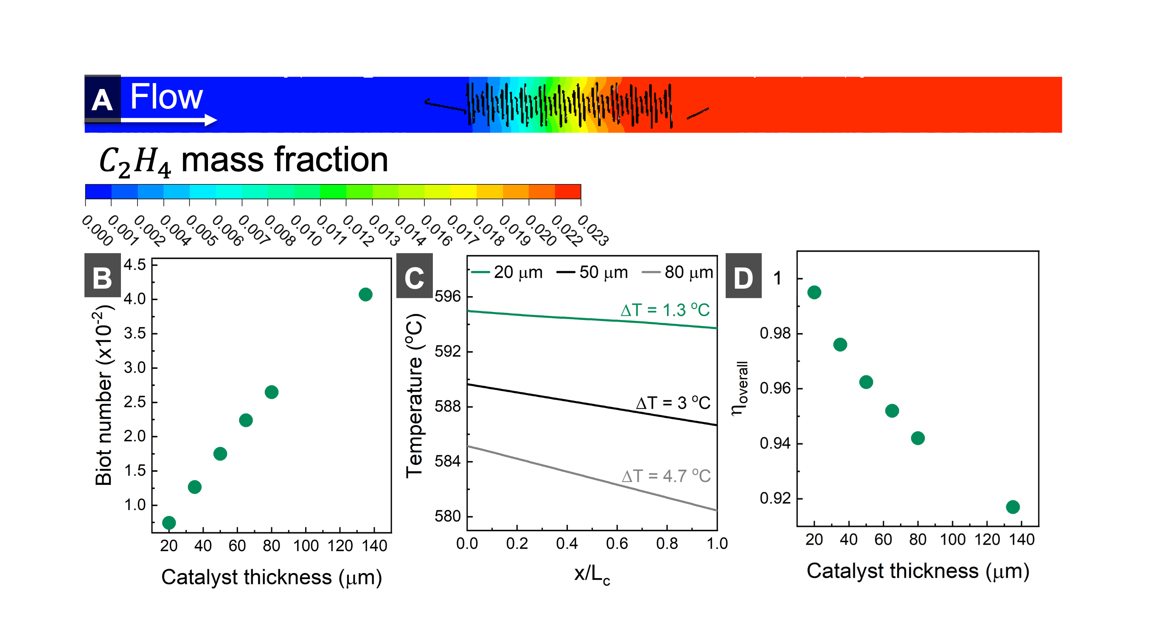
Figure 10

Slide 13
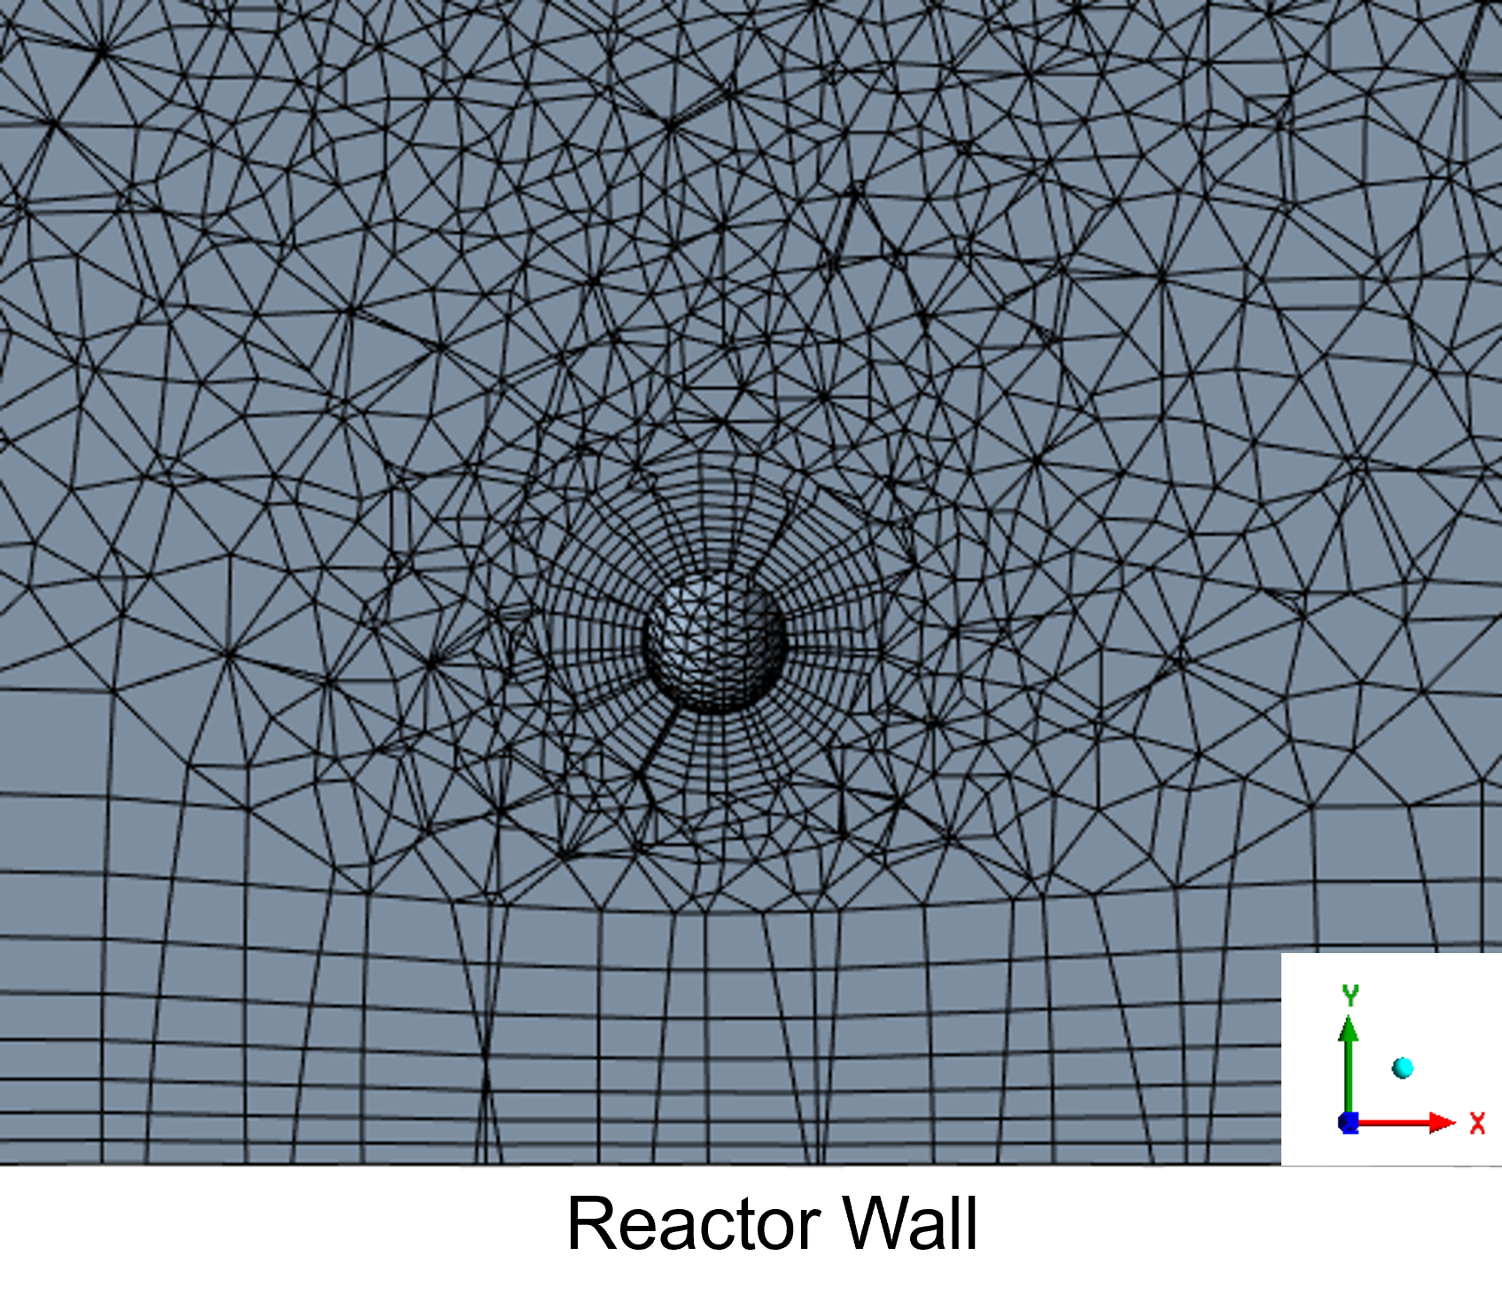
Figure S1

Slide 14
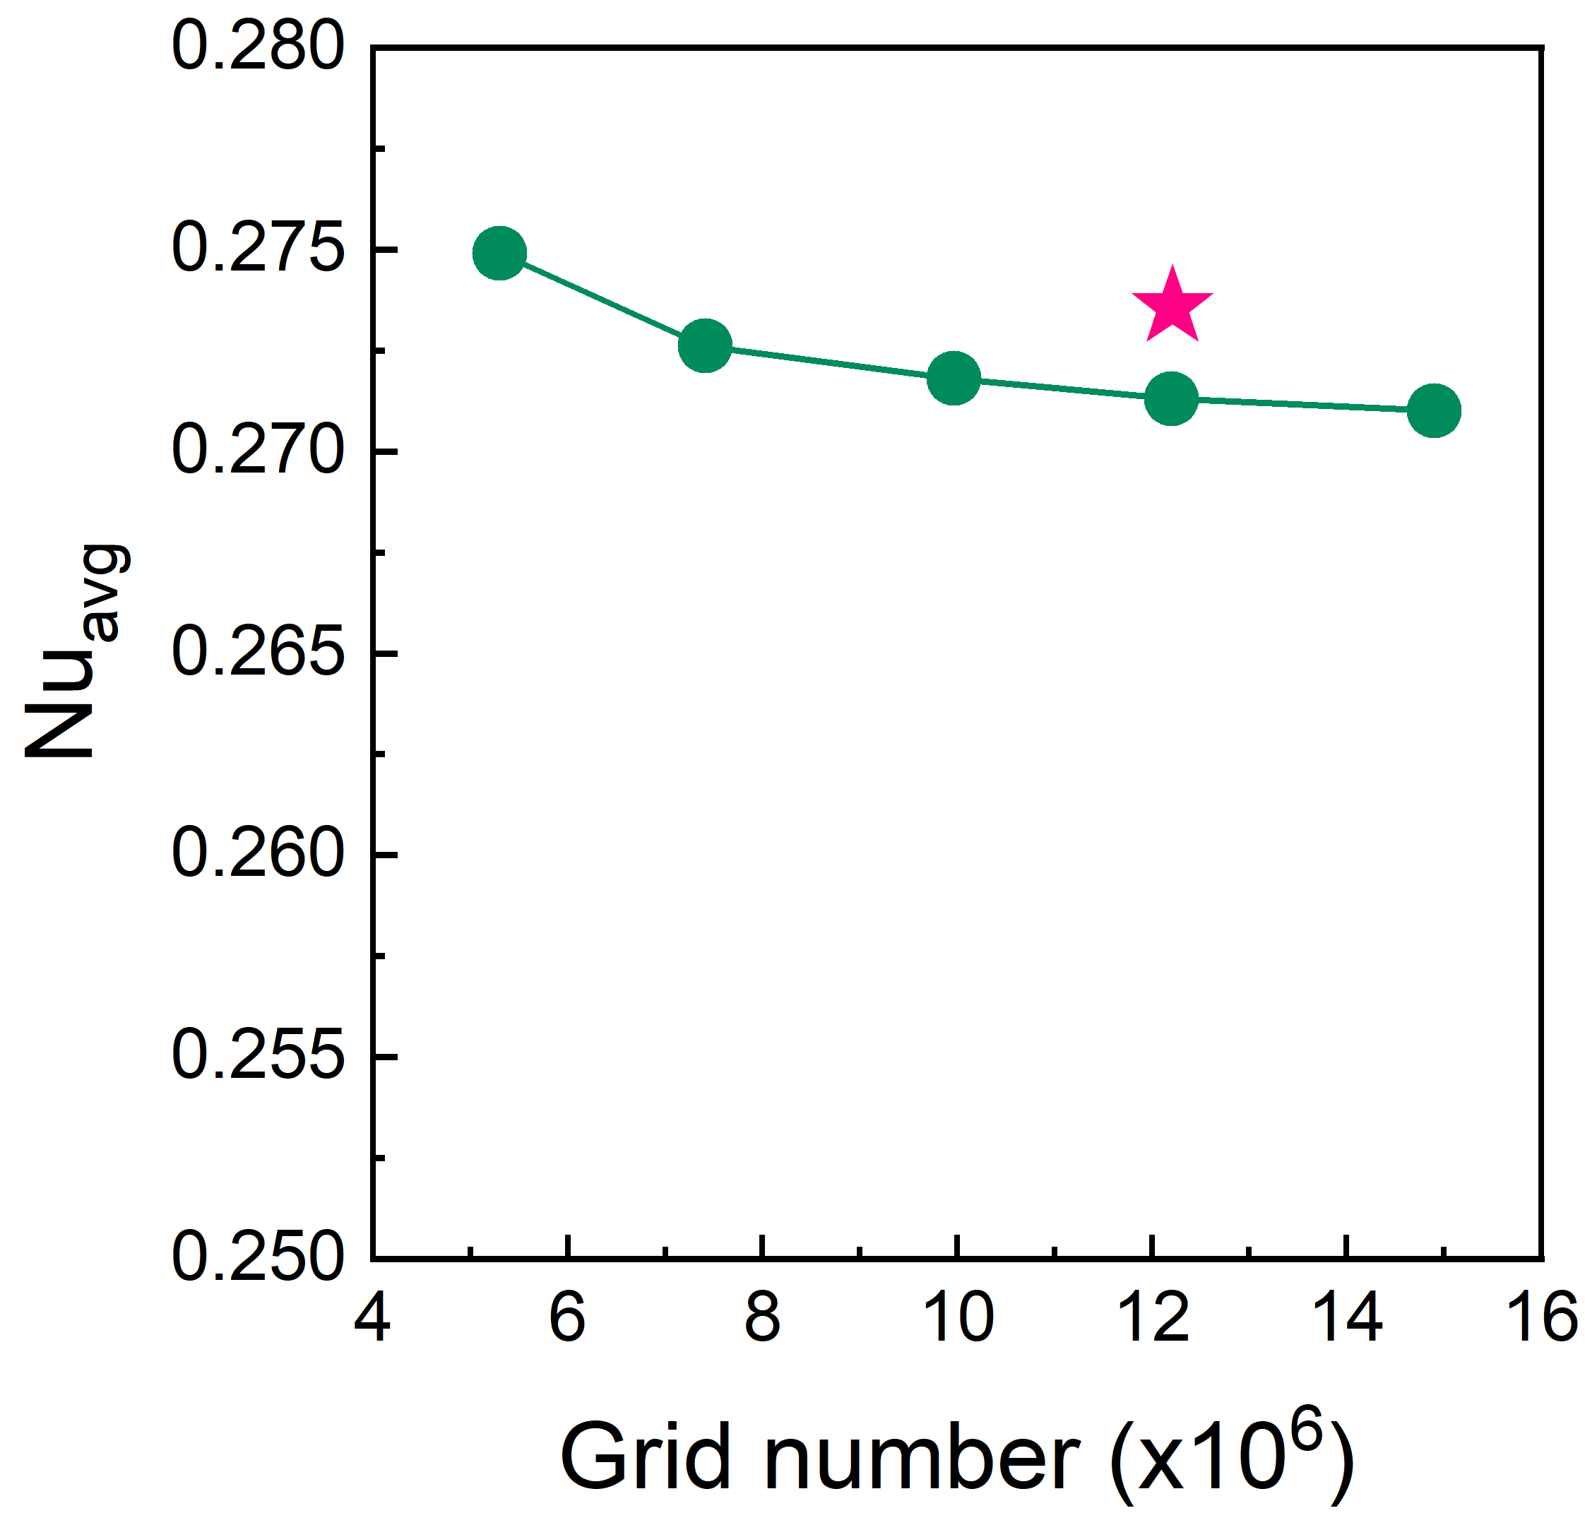
Figure S2

Slide 15
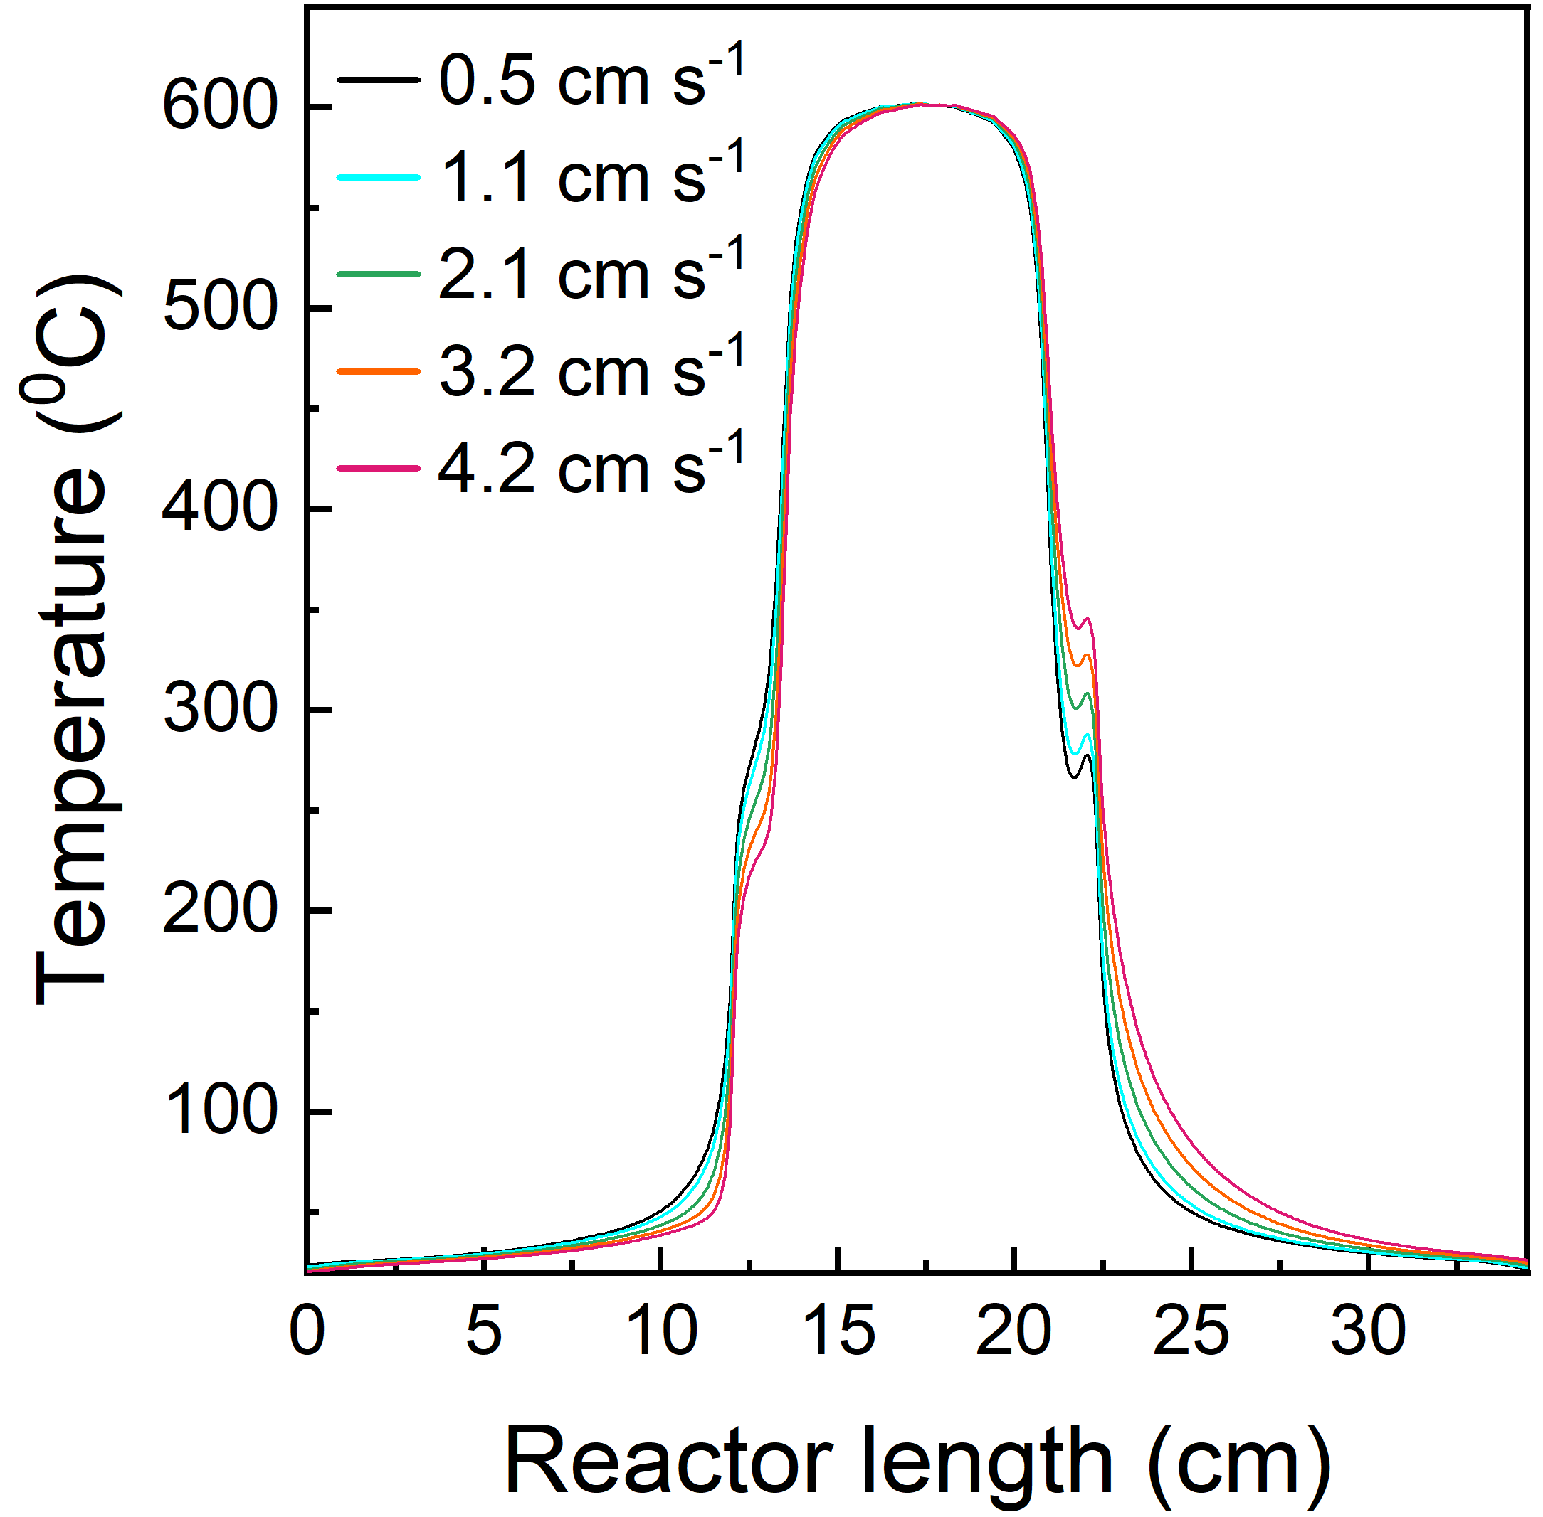
Figure S3

Slide 16
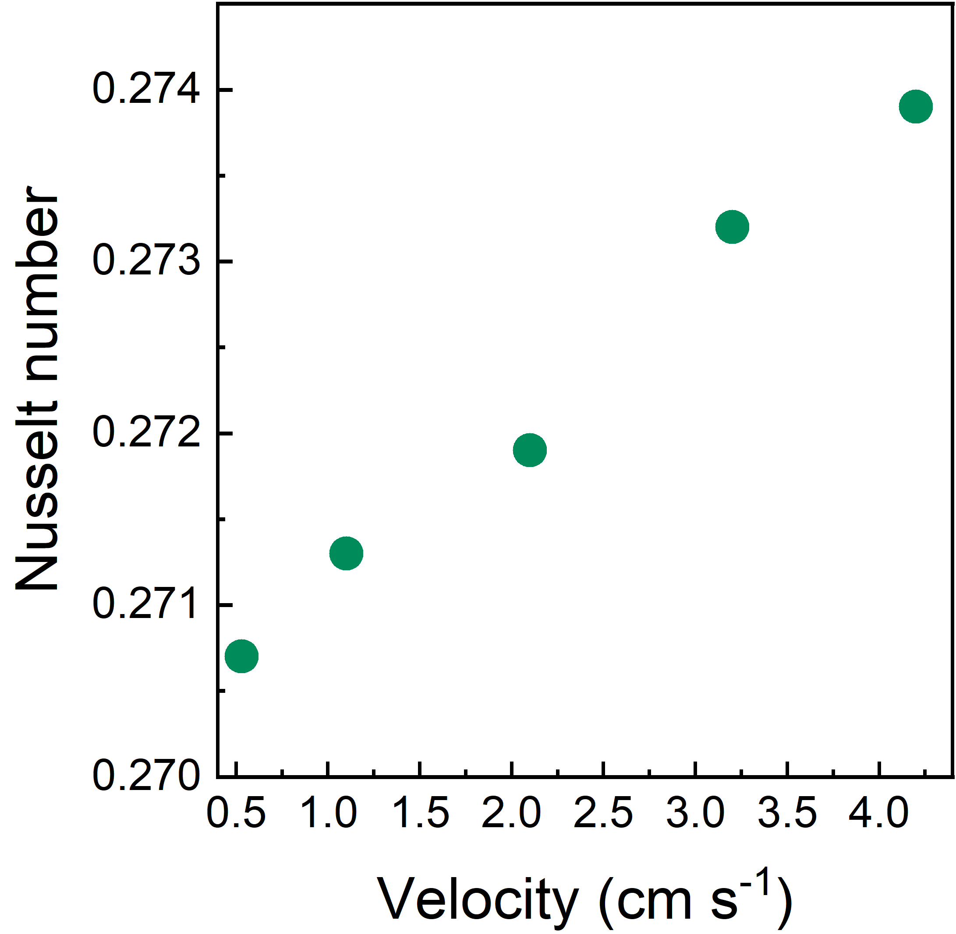
Figure S4

Slide 17
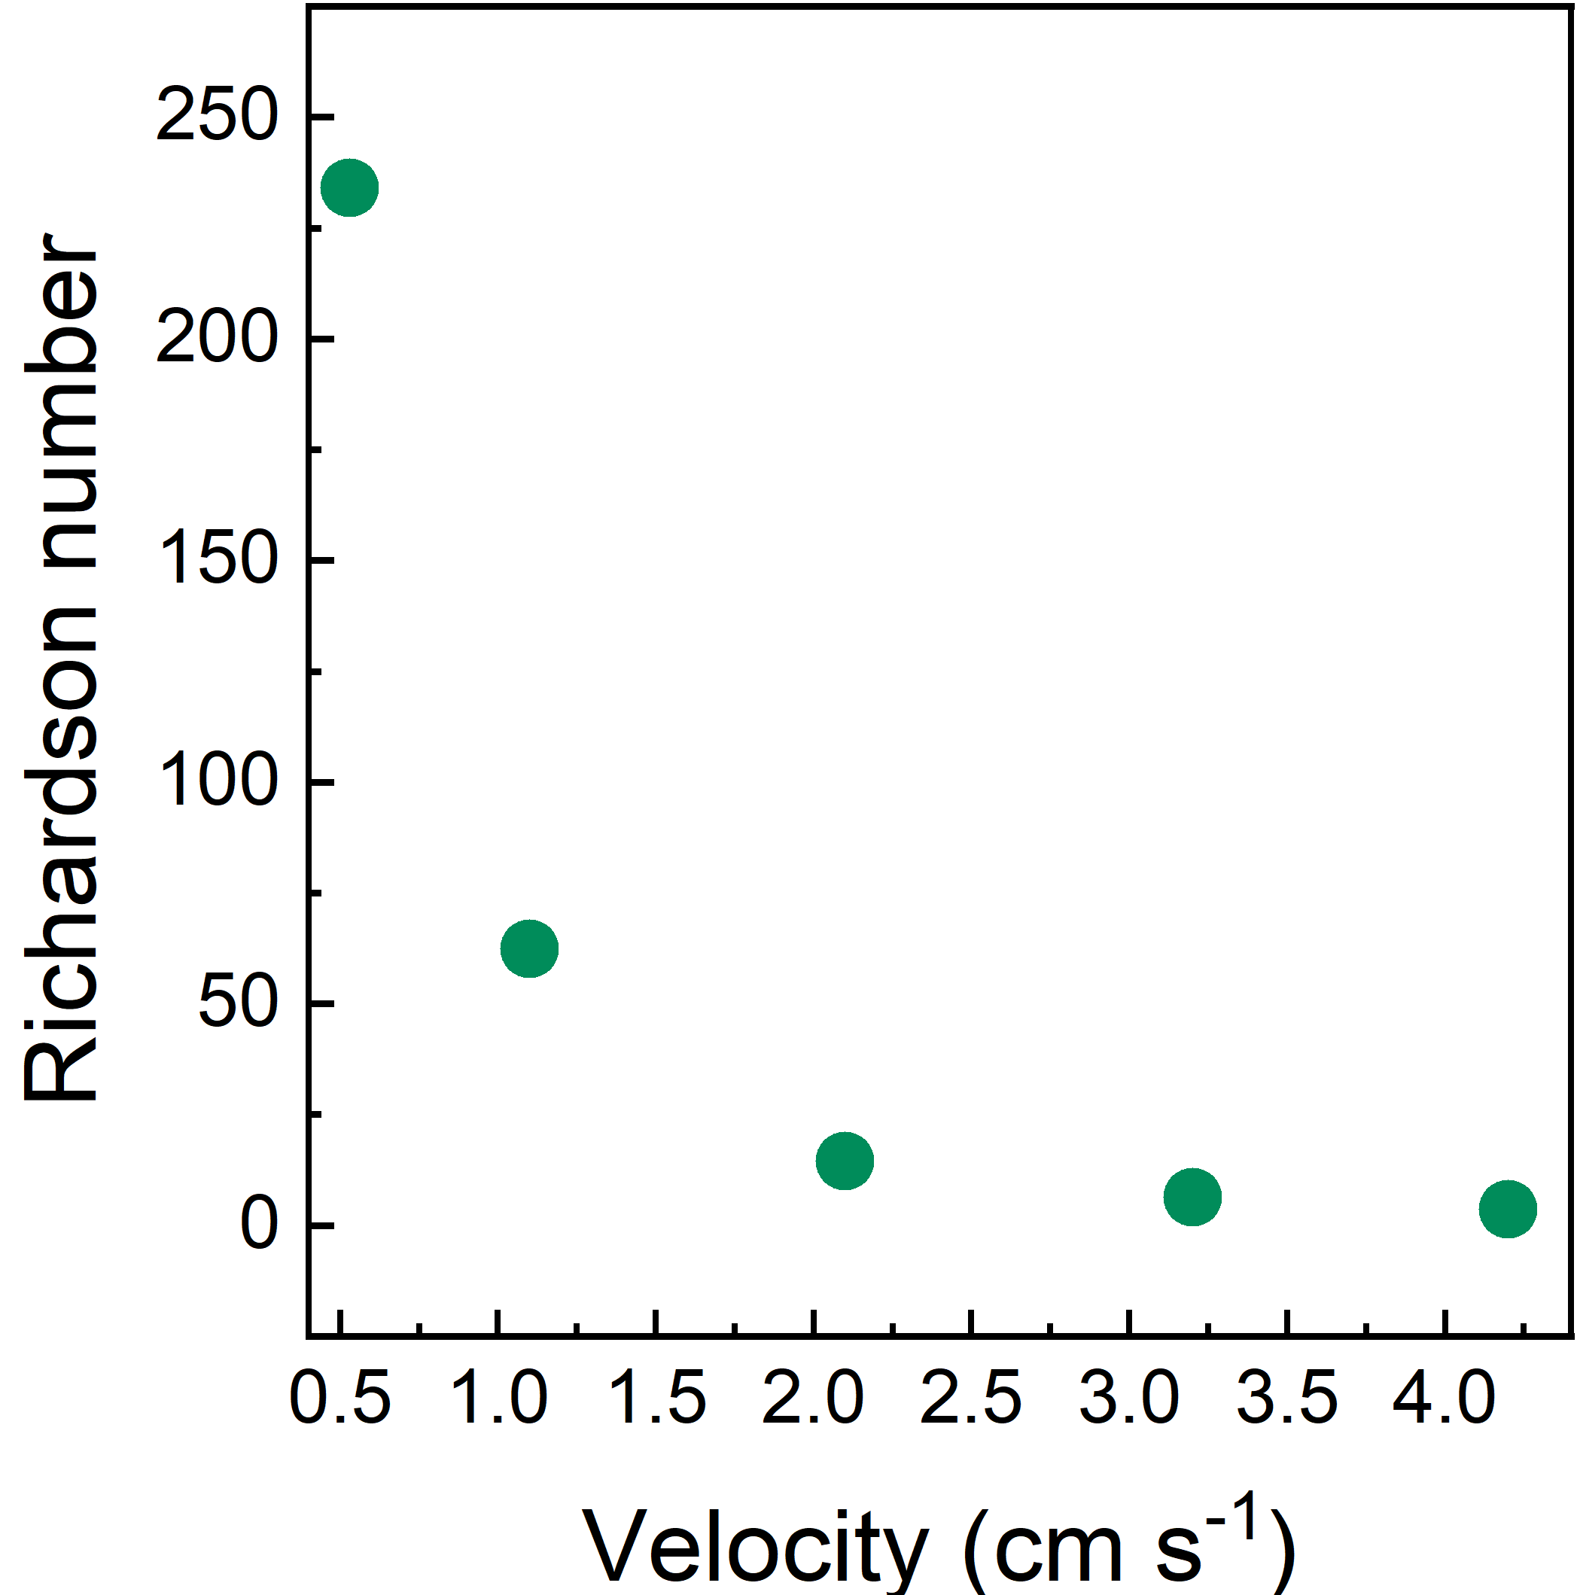
Figure S5

Slide 18
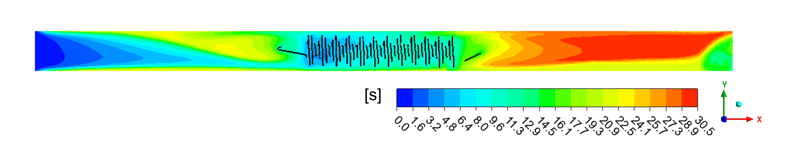
Figure S6

Slide 19
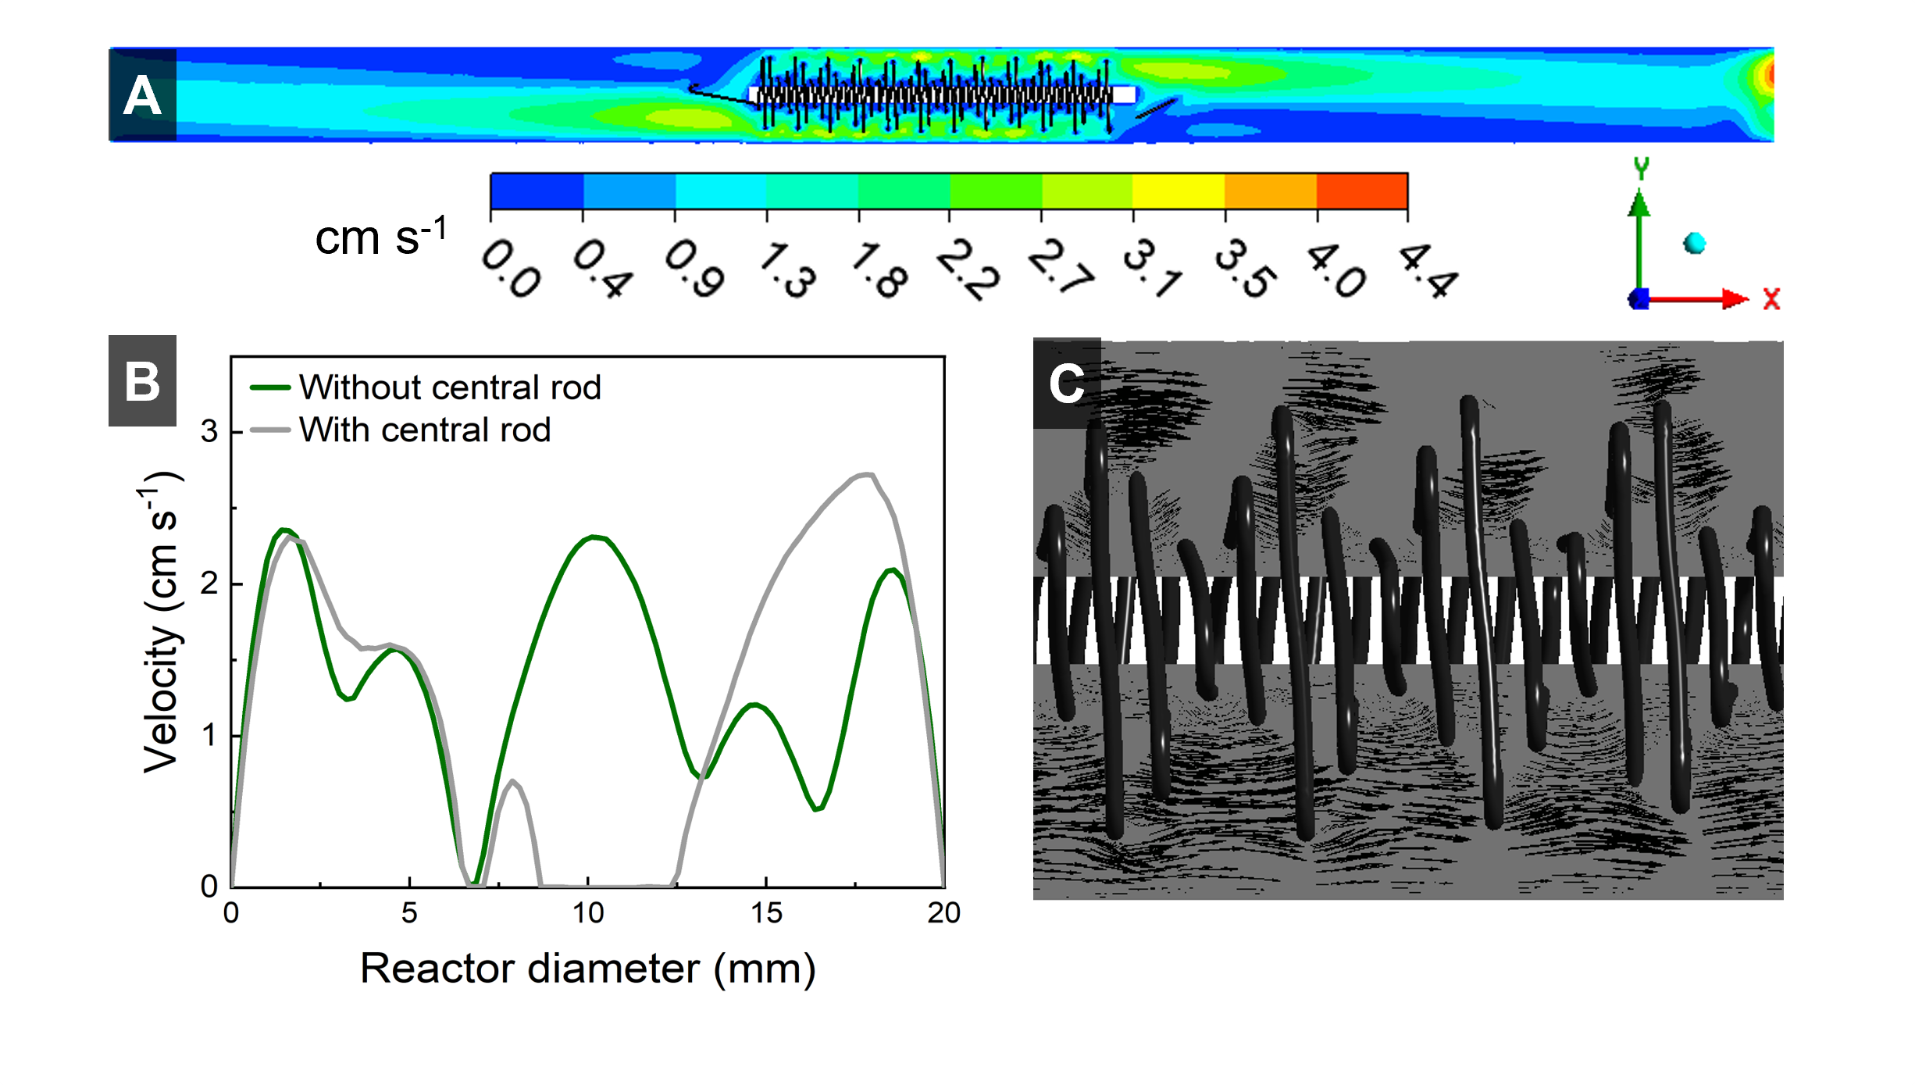
Figure S7

Slide 20
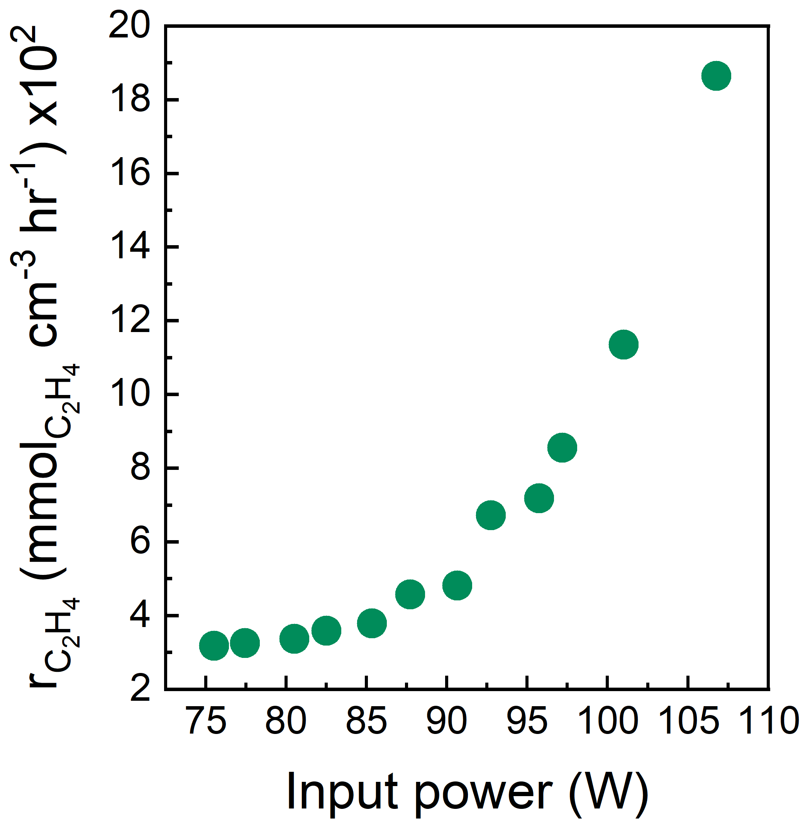
Figure S8

Slide 21
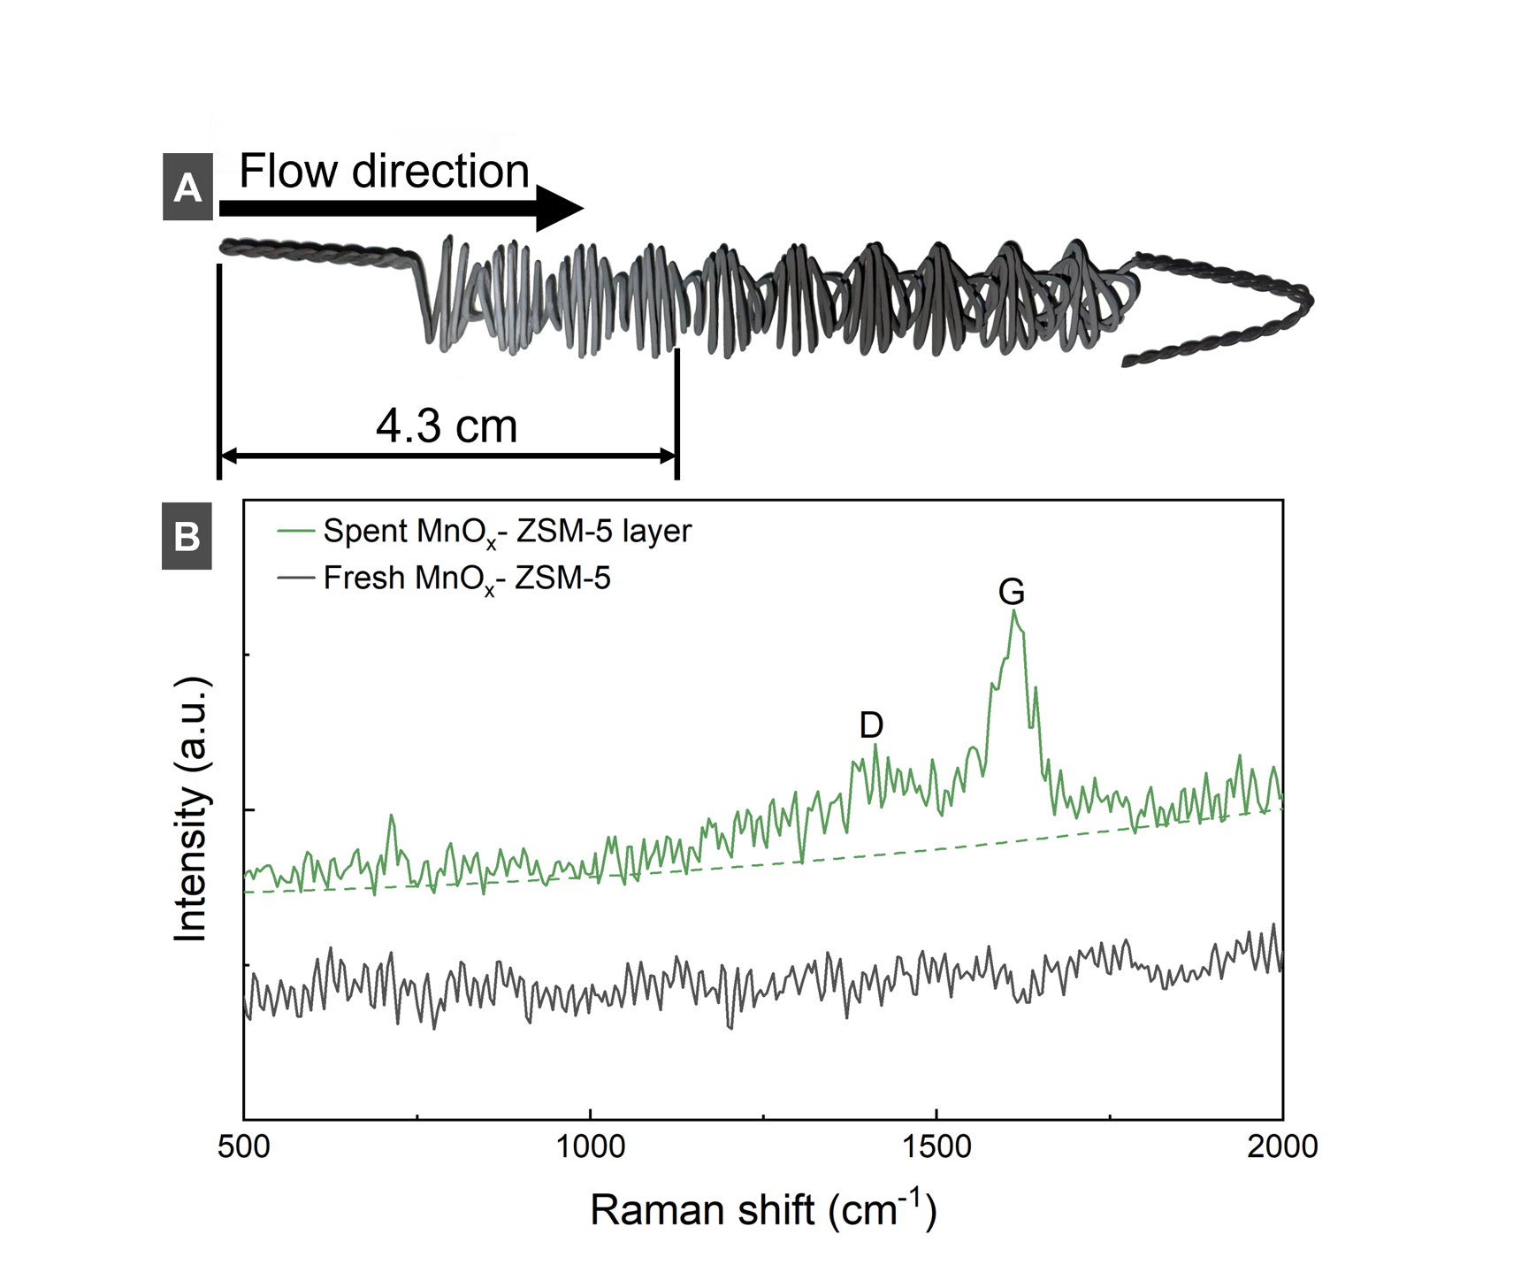
Figure S9

Slide 22
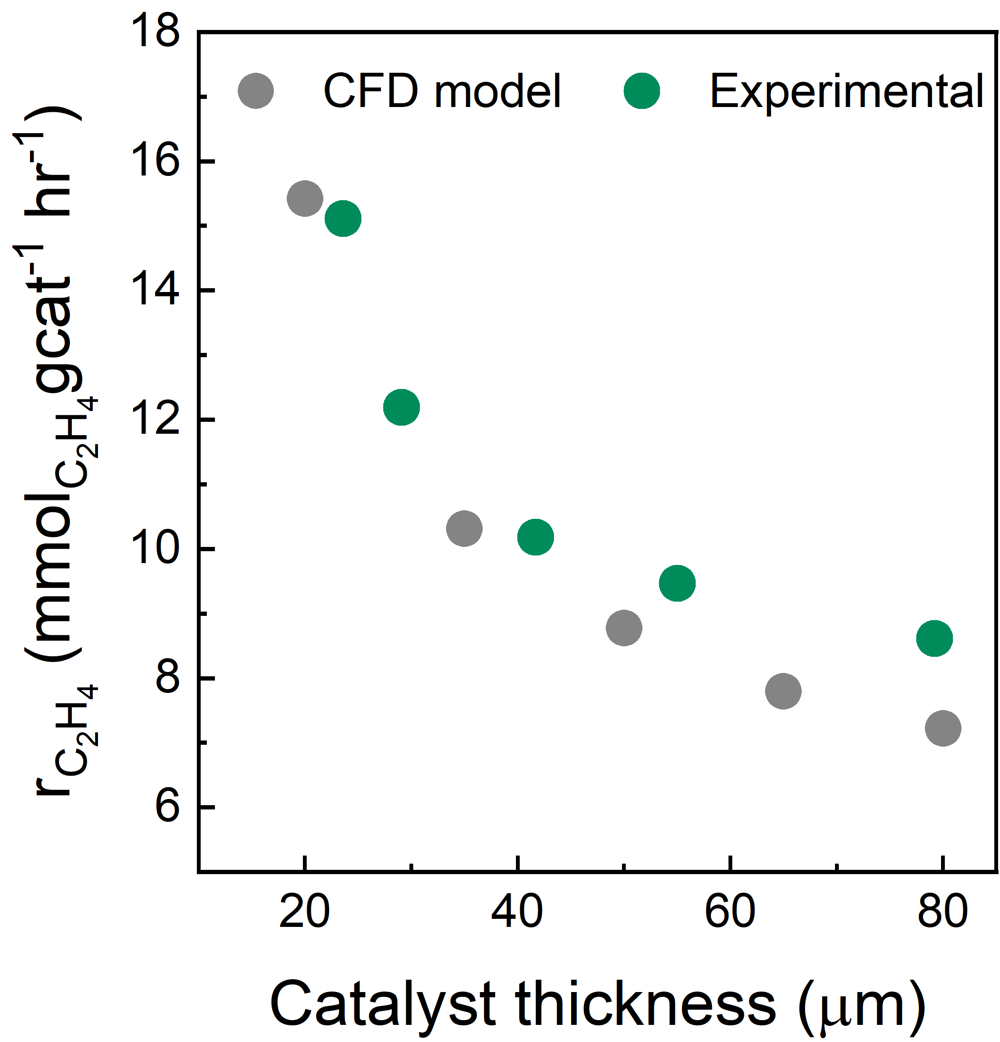
Figure S10

Slide 23
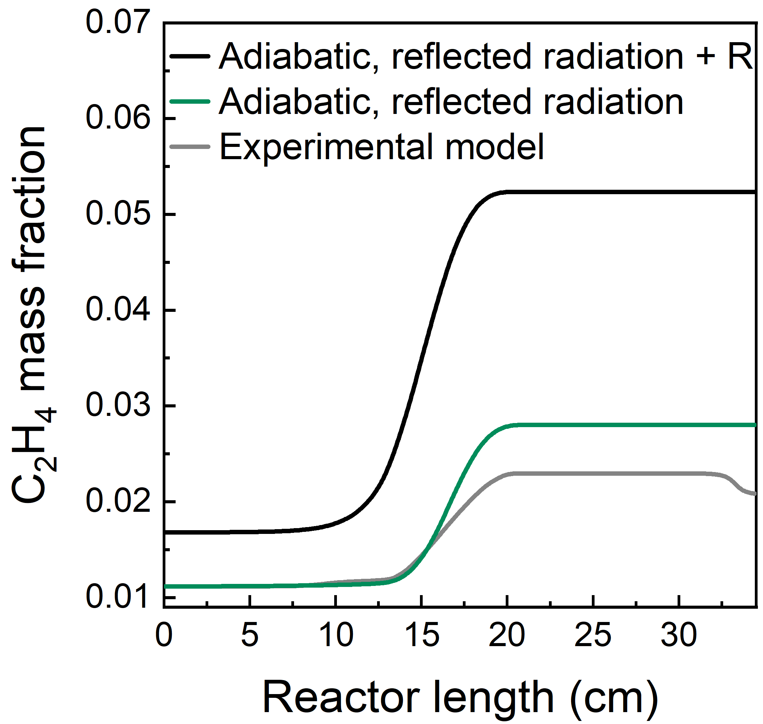
Figure S11

Slide 24
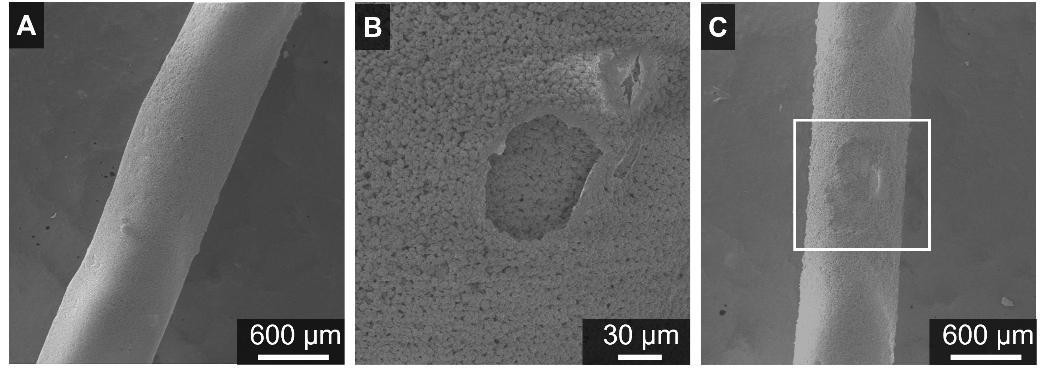
Figure S12

